Slide 1
EMERGENCY PROCEDURES
EMERGENCY NUMBER 111
SECURITY CONTACT EMERGENCY NUMBER: (04) 381 7747
Subsequent to an emergency call you MUST alert Security who can assist with other required services
LOCATIONS:
Te Papa Museum of New Zealand, Te Papa Tongarewa, 55 Cable Street, Te Aro, Wellington
Tory Street 169 Tory Street, Te Aro, Wellington
*** ONLY APPROVED PERSONS TO MAKE COMMENTS TO MEDIA ***
2023

Slide 2
DAMAGED COLLECTION ITEMS ON DISPLAY
Initial action | Remain Calm. Check your surroundings for immediate hazards – do not put yourself in danger. Do not move the object or taonga. Call the Visitor Services Manager 029 601 0340 Photograph the damage.
DAMAGED COLLECTION ITEMS ON DISPLAY

Slide 3
LOSS OF POWER
Initial action | Remain Calm. Check your surroundings for immediate hazards – do not put yourself in danger. Assist visitors and staff in your area. Proceed cautiously to an area that has emergency lighting or the nearest exit.
Information | Exit areas are lit by emergency lighting units. Emergency Generators should provide power for 2-3 days. If Emergency power is lost, Te Papa Hosts will move through all public spaces with flashlights, escorting visitors to safety. Te Papa Hosts and Security will secure galleries and storage areas from vandalism, intrusion and fire.
If you are stuck in a lift | Remain calm. Use the emergency button to notify the operator.
LOSS OF POWER

Slide 4
WATER INCIDENT
Initial action | Remain Calm. Check your surroundings for immediate hazards – do not put yourself in danger. Call security on (04) 381 7747 if an emergency or (04) 381 7101 if not life threatening. Advise them of the exact location and severity of water incident. Indicate whether a collection item has been damaged, or is in imminent danger.
Risk of Electrocution | Use extreme caution around electric appliances and electric outlets near the water. Do NOT stand in water. If there is any danger of electrocution – evacuate.
Water source | If the source of the water is known, and it is safe for you to stop it, then do so.
WATER INCIDENT

Slide 5
AGGRESSIVE PERSON / PSYCHIATRIC EMERGENCY
Initial action | Remain Calm. Check your surroundings for immediate hazards – do not put yourself in danger. Alert staff in the immediate vicinity, ask them to call for assistance.
AGGRESSIVE PERSON
Inform | Call Security (04) 381 7747 they will attend and coordinate the appropriate actions to be taken. Aggressive behaviour may require Police intervention.
PSYCHIATRIC EMERGENCY
Inform | Dial 111 and state ‘Psychiatric Emergency”, give exact location. Call Security (04) 381 7747 They will be able to help direct ambulance services. Contact a Mental Health First Responder and ask them to assist until the ambulance arrives.
AGGRESSIVE / PSYCHIATRIC PERSON

Slide 6
IF THERE IS AN EXPLOSION
Initial action | Remain Calm. Check your surroundings for immediate hazards – do not put yourself in danger. Be prepared for more explosions. Be prepared to evacuate, leaving doors closed behind you. Avoid objects that may fall on you such as windows, mirrors, overhead fixtures, filing cabinets, bookcases and electrical equipment. Be prepared for fire or power failure that can sometimes follow explosions. Be guided by the Floor Wardens or Te Papa Hosts.
Things to remember | Open doors carefully. Watch for falling objects. Do not use lifts.
Possible causes of explosions | Bombs. Flammable/explosive objects. Chemical accidents. Leaking gas. Faulty boilers. Motor vehicles. Lithium batteries (e.g. Electric scooters)
EXPLOSIONS

Slide 7
ACCIDENT AND INJURY
Initial action | Remain Calm. Check your surroundings for immediate hazards – do not put yourself in danger. Avoid moving the person, unless the situation around them is life threatening. Do not disturb the scene unless to prevent further injury.
First aid assistance | Minor injuries can be treated by local trained first aiders. A list of Te Papa’s First Aiders can be found on notice boards around Te Papa and on Kupenga.
Inform | In the event of a serious harm injury call 111 and ask for an ambulance. Give a description of the injury and patient’s location. Call security (04) 381 7747, they will be able to help direct ambulance services. All injury accidents and near misses must be reported to your manager without delay. Report all incidents, Accidents and Near Misses via the incident form on Kupenga to healthandsafety@tepapa.govt.nz. For all serious harm please advise the Health and Safety Manager.
AUTOMATIC EXTERNAL DEFIBRILLATOR (AED) LOCATIONS:
CABLE STREET Ground Floor – Security Control Room Level 2 – Host information desk Level 4 – Espresso café | TORY STREET Level 2 – Behind main reception desk on the wall
ACCIDENT AND INJURY

Slide 8
CHEMICAL SPILLS AND CHEMICAL FIRES
CHEMICAL SPILL
Initial action | Remain Calm. Immediately flush the affected area of your body with water. Use the nearest chemical showers and/or eye wash stations if available. Refer to the respective Safety Data Sheet regarding any additional medical treatment required.
Inform | Call Security (04) 381 7747.
Clean Up Spill | If you and a colleague have spill training AND an appropriate spill kit AND including all necessary PPE AND access to your personal respirators AND a copy of the respective Safety Data Sheet, you may attempt to clean up the spill, in pairs.
Possible evacuation | If you cannot clean up the spill, evacuate the area, until it is deemed safe to re-enter. For a major spill involving a hazardous chemical, operate the fire alarm. Staff who have been exposed to hazardous chemicals should be examined by a doctor as soon as possible, and no later than 24-48 hours.
CHEMICAL FIRE
Initial action | Remain calm. If you discover a fire and activate the nearest fire alarm.
Inform | Call Security (04) 381 7747.
Extinguish | If the fire is small AND you have had fire extinguisher training AND you can extinguish it in less than 5 seconds, THEN you can put it out with dry powder – NEVER WATER. Always keep a clear exit path.
Evacuate | Close doors and windows behind you to confine the fire. Go to the Assembly point.
CHEMICAL SPILLS AND CHEMICAL FIRES

Slide 9
LOCKDOWN
Initial action | Remain Calm Check your surroundings for immediate hazards – do not put yourself in danger. Assist with announcement of the lockdown by telling others ESCAPE if you can. Only attempt to do this if you are certain that the move is less risky than staying in place HIDE Shut the blinds or pull the shades down. Turn off the lights and try to give the impression that the room is empty Lock or barricade all doors where possible, use furniture or desks as cover, Stay low, away from windows and doors Immediately put all mobile phones on “vibrate” or “silent” mode TELL Call the Police by dialling 111 when it is safe Security will lock entry into building with electronic security
Other information | If you are directed by police to leave your secured areas, assist others in moving as quietly and quickly as possible If you encounter police, keep your hands elevated with palms open and visible and obey all police instructions Be aware that law enforcement officers are trained to go directly to the threat and engage it. They may not stop to assist you escape or treat injured persons. Do not do anything that would slow them down or hamper their attempts to eliminate the threat. If you are outside of a building when a lockdown is announced, hide behind a large heavy object (i.e. vehicle or tree) only leave your location if you can be sure it is safe to do so, or dangerous to stay.
Actions you should NOT take | DO NOT hide in washrooms DO NOT respond to anyone at the door until an “all clear” message is received via SMS from Security, or in person from the police DO NOT sound the fire alarm in the building unless there is a fire. Unless in immediate danger, DO NOT attempt to leave the building until told to do so by police or Security
LOCKDOWN

Slide 10
EARTHQUAKE
Initial action | Remain calm DROP down on your hands and knees. COVER your head and neck. HOLD on to your shelter. If you are away from your desk, seek shelter in a secure position such as a doorway Keep away from windows Beware of falling ceiling tiles, light fittings etc
When the shaking stops | If there is structural damage evacuate to your assembly area Otherwise, remain where you are until the risk of further tremors or danger from falling objects have ceased Make verbal contact with others to identify the severity of the situation Follow the instructions of your Floor Warden
Things to remember | Life comes before collections and property Check your surroundings for immediate hazards – do not put yourself in danger Do not use the lifts Avoid ‘live’ electricity - Avoid hanging cables, light fittings, or any metal objects or water that might be in contact with loose wires Be careful when using the stairs – they could have been weakened or dislodged by the earthquake
CABLE STREET TSUNAMI EVACUATION INFORMATION
If you feel a strong earthquake that makes it hard to stand or a long earthquake that lasts more than a minute. See a sudden rise or fall in sea level. Hear loud or unusual noises from the sea, move to higher ground – this is level 2 and above in Te Papa. Tory Street is not in the tsunami evacuation zone.
EARTHQUAKE

Slide 11
BOMB THREATS AND SUSPICIOUS OBJECTS
BOMB THREATS VIA PHONE
Initial action | Remain calm, be polite and show interest Try to keep the caller talking Listen carefully and gather information Refer to bomb threat check list (next page)
Pass message to colleague | If possible, write a note to a colleague asking them to call Security (04) 381 7747
When caller hangs up | Inform Security Manager 021 193 2835 Write out a bomb threat report promptly and give it to the Security Manager or IMT Controller with all the details that you can remember, for use by Security and Police Do not discuss the threat with other staff
SUSPICIOUS OBJECTS
Initial action | Remain calm Check your surroundings for immediate hazards – do not put yourself in danger DO NOT handle or go near a suspicious parcel or object
Inform | Call Security (04) 381 7747 Then put mobile phones and radios on “silent”
Record details | Write down all the details that you can remember regarding how you found the object or how it was delivered (they will be used by Security and Police)
Observe safety precautions | Do not discuss the parcel/object with other staff Be guided by Security If evacuation is ordered, it may be by word of mouth. Go to the Assembly area. Take your personal belongings, (car keys etc), with you.
BOMB THREATS AND SUSPICIOUS OBJECTS

Slide 12
BOMB THREATS RECEIVED VIA PHONE CHECKLIST
REMEMBER – REMAIN CALM AND DO NOT HANG UP
Write down the threat Note EXACT wording
QUESTIONS TO ASK CALLER
When will the bomb exploded? What does the bomb look like? What kind of bomb is it? What will make the bomb explode? Did you place the bomb? | Where is the bomb? Are you familiar with the area? Why did you place the bomb? What is your name? Where are you? What is your address?
The caller’s voice, features to note:
The use of language, features to note:
Accent (specify) Any impediment (specify) Voice (loud, soft etc) Speech (fast, slow etc) Diction (clear, muffled) Manner (calm, emotional etc) Do you recognise the voice? If so, who do you think it is? | Well Spoken? Incoherent? Irrational? Taped? Message read by caller? Abusive? Other features?
Note any background noises. For example:
Street noises House noises Aircraft Voices Diction (clear, muffled | Music Machinery Other noises Local call/Long distance Message read by caller?
Callers age and sex
Male Female Age | Date Time Length
BOMB THREATS RECEIVED VIA PHONE CHECKLIST

Slide 13
FIRE AND EVACUATION
Only attempt to put out a fire if it is safe to do so, ie. If it is small, you are trained in extinguisher use, and a safe exit path has not been blocked.
Initial action | Remain calm. If you discover a fire and activate the nearest fire alarm.
Evacuate the building | Upon hearing a fire alarm evacuate your building. Follow the instructions of the Floor Wardens. Cable Street staff proceed to the Assembly Area in the Car park on the corner of Barnett and Cable Streets. Tory Street staff proceed to the Pukeahu Park War Memorial adjacent to Tory Street.
Be prepared | In advance, each staff person and volunteer should: Understand this evacuation procedure. Know the name of the Floor Wardens and Deputy Warden. Recognise the sound of the evacuation alarm as the continuous sound of a siren. Know at least two ways out of the building from your regular workspace. Know the location of your nearest fire alarm and exit.
Evacuation alarm | If you hear the alarm or are asked to evacuate the building. Remain calm. Immediately shut down all machines and equipment – (not computers). Leave quickly.
Everyone must evacuate quickly | The Floor Warden in each area is responsible for ensuring everyone in their area is evacuated. Please assist by follow the warden’s instructions. As they leave, staff should check that others in the workspace are also leaving.
People requiring assistance | Assist members of the public or anyone who may need direction, or physical. assistance. Anyone who cannot be assisted downstairs should be accompanied to a landing in an emergency stairwell and the Chief Warden notified.
As you leave | Shut all doors behind you (closed doors slow the spread of fire, smoke and water). Do not use lifts. Proceed as quickly as possible in an orderly manner, without pushing or shoving. Hold handrails when you are walking on stairs.
Once out of the building | Move away from the building/space. Proceed to Assembly areas. Meet with other members of your department and remain in the Assembly Area. and wait for further instructions.
Useful things to know | Oxygen feeds fire. Close doors; do not open windows.
Hot or smoking doors | Do NOT open hot or smoking doors ACTION: before opening any door, touch it near the top.
FIRE AND EVACUATION

Slide 14
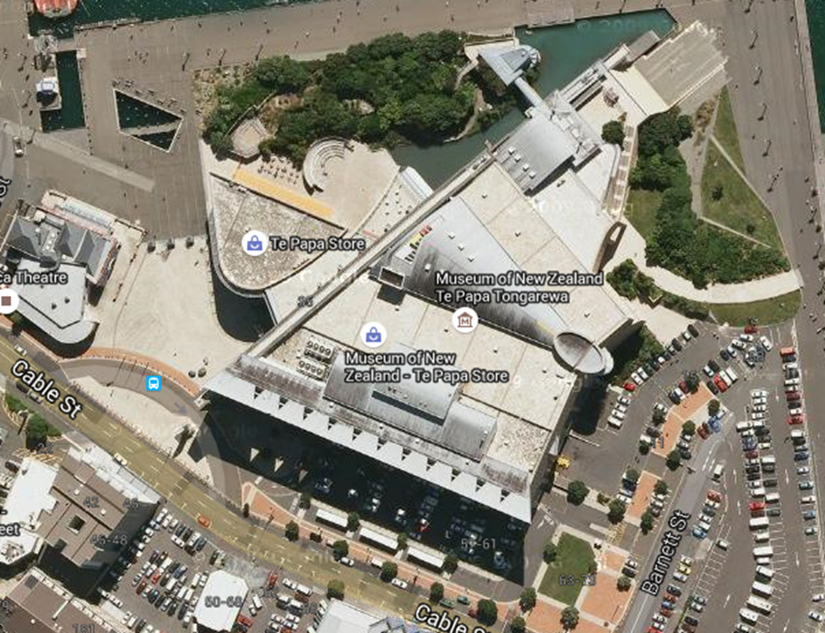
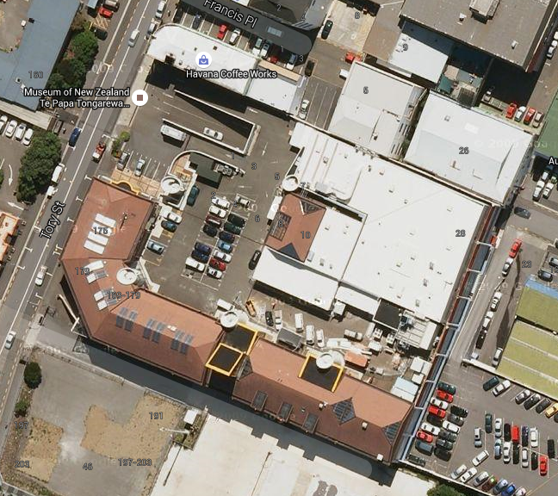
ASSEMBLY AREAS
CABLE STREET Car park on the corner of Barnett and Cable Streets
KEY
ASSEMBLY AREA
TORY STREET Pukeahu Park War Memorial adjacent to Tory Street.

